Slide 1


Slide 2

Aspect Level Sentiment Analysis of E-Commerce: A Case Study of eBay and Amazon
THESIS DEFENSE
Student name: Furqan Durrani
Supervisor(s) Name: Dr. Muhammad Aasim
Qureshi
Department of Computer Sciences, Bahria University Lahore Campus, Lahore

Slide 3
Layout
Introduction
Background/Literature Review
Research problem
Research Question
Aims and Objectives
Methodology
Implementation Techniques
Results
Conclusion
References

Slide 4
Introduction
Sentiment Analysis
Sentiment analysis is a natural language processing technique used to determine whether data is positive, negative or neutral. Sentiment analysis is divided into three types.
Types of Sentiment Analysis
Document Level Sentiment Analysis
Sentence Level Sentiment Analysis
Aspect Level Sentiment Analysis

Slide 5

Introduction (cont…)
E-commerce is the buying and selling of goods or services over the internet
E-commerce is becoming a new form of trade rapidly because of the following:
Shop anything from anywhere and anytime.
Number of varieties.

Slide 6
Introduction (cont.)
Retail sale of e-commerce is increased from 1336 billion USD to 4206 USD in the last 6 years, and it is expected to be increased 6388 billion U.S. dollars in next three years [1].
During pandemic (COVID-19), sales of Amazon and eBay was 4059M and 1227M respectively [2].

Slide 7
Literature Review
Ref. No. | Year of Publication and Author | Dataset | Techniques | Accuracy
[3]. | 2020 Asif, N. | Mobile reviews dataset | multilevel relational classification | 90.50
[4]. | 2020 Cai, X | JingDong mobile review data | SA-Bert | 91.35
[5] | 2020 Marshan, A. | Amazon review data. | NB, KNN, SVM | 86.3
[6] | 2020 Lu, Q. | SemEval 2014 and ACL 2014 Twitter Dataset datasets | Interactive rule attention network (IRAN) | 81.96
[7] | 2020 Xu, F. | Amazon Product and movie review dataset | Naïve Bayes | 75.68

Slide 8
Literature Review
Ref. No. | Year of Publication and Author | Dataset | Techniques | Accuracy
[8] | 2020 Abraham, M | Mobile review dataset | BNB, KNN | 91.5
[9] | 2019 Patil, P | Amazon review data | NB, SVM and LR | 81.5
[10] | 2019 ASHWATH, K | Client audit data | POS tagging, NB, SVM | 81.30
[11] | 2018Vanaja, S | Amazon customer review data | POS tagging, SVM and NB classifiers | 90.42
[12] | 2017 Asha, S. | Movie reviews | SVM, Gini Index | 94.10

Slide 9
Research Gap
In research [3], two aspects (battery and android version) were covered and analysed.
In research [12], maximum accuracy of 94% was achieved with the help of SVM and Gini Index.
It was required to study further aspects of mobile and the accuracy of the model is much important to analyses the reviews and predict the result accurately. So, it is required to increase the accuracy of the system.

Slide 10
Research Question
How to analyse the consumer's sentiments at aspect level?
How to develop a classification model to perform sentiment analysis at an aspect level with higher accuracy?

Slide 11
Aim and Objectives
The main objectives of this research is:
To scrape data from eBay and amazon
To perform sentiment analysis at aspect level and increase the accuracy of a classification model.

Slide 12
Methodology
Phase I:
Literature Review and Problem Statement
Literature Review
Problem Statement
Phase II:
Data Collection
Data Collection
Phase III:
Pre-processing
Pre-processing
Phase IV:
Classification
Classification
Results and Discussion
Phase V:
Result and Discussion
Conclusion

Slide 13
Data Collection
Reviews dataset_1 has been collected from the following source:
https://data.world/promptcloud/amazon-mobile-phone-reviews
4304 reviews dataset is extracted as the following.
Polarity | Reviews Count
Positive | 1455
Negative | 1455
Neutral | 1394

Slide 14
Data Collection (cont…)
Sample dataset_1 is as the following:
Product Name | Brand Name | Price | Rating | Reviews | Voting
Samsung Galaxy S Duos GT-S7562 GSM Unlocked | Samsung | 95.88 | 5 | Excelente, it was what I expected. | 0

Slide 15
Data Collection (cont…)
Review dataset_2 has been collected from https://www.kaggle.com/wojtekbonicki/ebay-reviews the dataset_2 as the following:
Sentiments | Count
Positive | 4916
Negative | 4296
Neutral | 4383

Slide 16
Data Collection
Sample dataset_2 is as the following:
category | Review Title | Review Content | Rating
Headsets | Wireless gaming headset | This gaming headset ticks all the boxes # looks grate # built to last # excellent sound & mic # com... | 5

Slide 17
Data Collection (cont…)
Review dataset_3 has been collected from the following two sources:
33324 reviews dataset is crawled from eBay.
252231 reviews dataset is collected Amazon data from the website (https://jmcauley.ucsd.edu/data/amazon).
To increase the data size, both datasets are combined for better analysis.

Slide 18
Data Collection (cont…)
Sample dataset_3 is as the following:
Product Name | Review Date | Review Author | Review Title | Review Text | Review Rating
Apple iPhone 7 128GB Rose Gold (Unlocked) A1778 (GSM) | 4-Sep 18 | 2006yushan | Volume control can be better | One thing that can be better is the volume. | 5

Slide 19
Data Pre-processing
The following pre-processing techniques has been applied in this study.
Tokenization
The raw data is converted into small tokens.
Punctuation Removal
Punctuation is removed in this technique.
Numeric Removal
Numeric values are removed from the reviews to improve its quality
Lower Casting
All the letters are converted to lowercase

Slide 20
Data Pre-processing (cont…)
Stemming
used to transform words into their root form.
Stop Words Removal
To remove the data that has no use in the classification.
Data set will be look like the following after pre-processing:
Before Preprocessing | After Preprocessing
I would like to introduce Mr. David as new Sales Manager, he’ll start his job on Oct 01, 2021. | like introduce david new sale manager start job oct

Slide 21
Data Pre-processing (cont…)
Features Based Data Extraction
Parts of speech tagging technique is implemented on the dataset_3 to extract the feature based dataset as the following:
Description | POS Tags | Indication
Noun | NN | Aspect
Adjective | JJ | Sentiment
Verb | VB | Sentiment
Adverb | RB | Sentiment

Slide 22
Data Pre-processing (cont…)
Following number of reviews have been extracted from the data set with respect to the aspects with POS tagging:
Aspect | Total Count | Positive | Negative | Neutral
Size | 6969 | 5262 | 1358 | 345
Price | 32139 | 24105 | 6592 | 1417
Service | 6901 | 5023 | 1515 | 360
Weight | 2068 | 1524 | 467 | 75
Color | 3074 | 2239 | 680 | 153

Slide 23
Data Pre-processing (cont…)
Due to imbalance feature based dataset, the following two techniques have implemented:
Under-sampling
Select subset of majority class and keep the minority class as it is.
Random under-sampling has been used.
Over-sampling
Replication of the minority class by adding more observations.
To avoid replication, AI based technique (SMOTE) used for oversampling.

Slide 24
Data Pre-processing (cont…)
Synthetic Minority Oversampling Technique
Identify the feature vector and its neighbor.
Take the difference between two.
Multiply the difference with random number between 0 and 1.
Identify new point on line segment by adding random number to feature vector.

Slide 25
Comparative Analysis on DataSet_1
Models | Accuracy | F1 Score
Support Vector Machine | 9186 | 0.92
K-Nearest Neighbor | 0.7595 | 0.75
Gaussian Naïve Bayes | 0.85 | 0.85
Logistic Regression | 0.92799 | 0.93
Random Forest | 0.92 | 0.92
Voting Classifier (Logistic Regression +Random Forest) | 0.9314 | 0.93
Voting Classifier (Random Forest + Support Vector Machine) | 0.9268 | 0.93
Voting Classifier (Logistic Regression + Support Vector Machine) | 0.9233 | 0.92
Recurrent Neural Network | 0.80 | 0.76
Base Paper Technique (Gini Index + SVM) | 0.8466 | 0.85

Slide 26
Comparative Analysis on Dataset_2
Models | Accuracy | F1 Score
Models | 0.89 | 0.89
Support Vector Machine | 0.72 | 0.71
K-Nearest Neighbor | 0.65 | 0.64
Gaussian Naïve Bayes | 0.89996 | 0.90
Logistic Regression | 0.87 | 0.87
Random Forest | 0.90069 | 0.90
Voting Classifier (Logistic Regression +Random Forest) | 0.89371 | 0.89
Voting Classifier (Random Forest + Support Vector Machine) | 0.89334 | 0.89
Voting Classifier (Logistic Regression + Support Vector Machine) | 0.82 | 0.77
Recurrent Neural Network | 0.76 | 0.76

Slide 27
Comparative Analysis on Dataset_1 and Dataset_2
Models | Accuracy | F1-Score
Models | 0.88 | 0.88
Support Vector Machine | 0.55 | 0.50
K-Nearest Neighbor | 0.55 | 0.51
Gaussian Naïve Bayes | 0.88 | 0.89
Logistic Regression | 0.83 | 0.83
Random Forest | 0.89 | 0.88
Voting Classifier (Logistic Regression +Random Forest) | 0.88 | 0.88
Voting Classifier (Random Forest + Support Vector Machine) | 0.89 | 0.89
Voting Classifier (Logistic Regression + Support Vector Machine) | 0.45 | 0.40
Recurrent Neural Network | 0.87 | 0.87

Slide 28
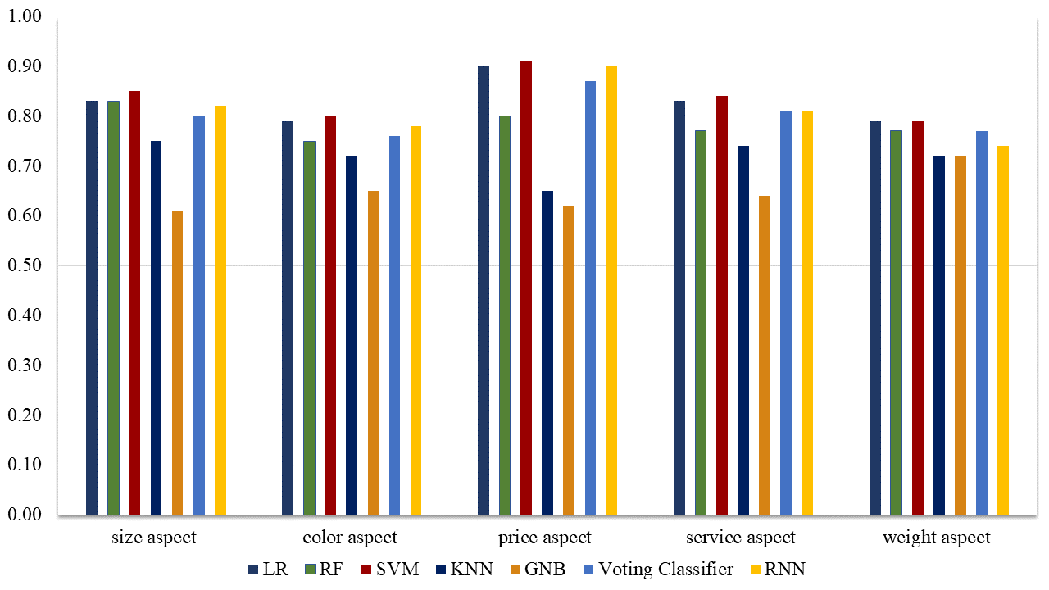
Performance Comparison of Proposed Methodology and Machine Learning Models
Performance Comparison of Proposed Methodology and Machine Learning Models on aspect based data set with imbalance data.

Slide 29
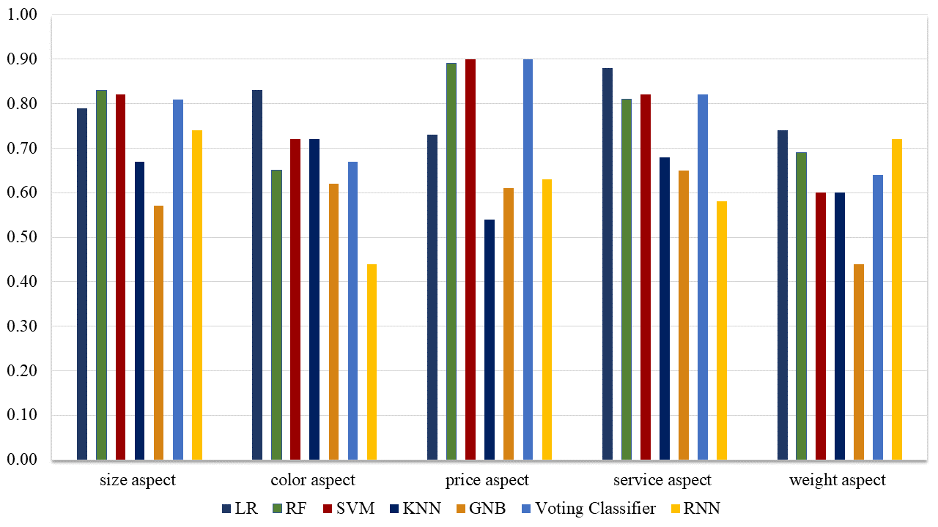
Performance Comparison of Proposed Methodology and Machine Learning Models
Performance Comparison of Proposed Methodology and Machine Learning Models on aspect based data set with undersampled data.

Slide 30
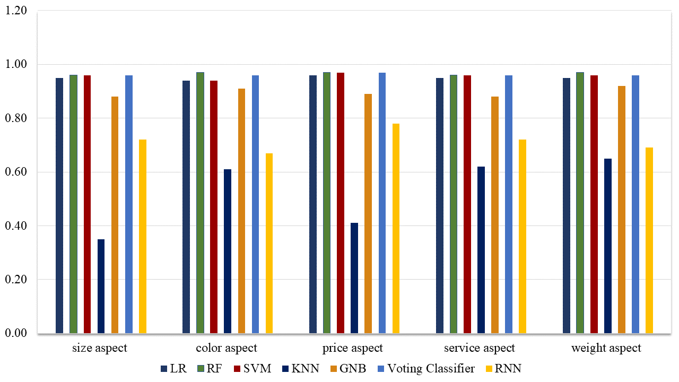
Performance Comparison of Proposed Methodology and Machine Learning Models
Performance Comparison of Proposed Methodology and Machine Learning Models on aspect based data set with oversampled data.

Slide 31
Conclusion
Different mobile review datasets of eBay and Amazon has been collected.
Different Pre-processing techniques are applied.
Data sampling techniques are implemented for imbalance dataset.
Combination of Logistic Regression and Random Forest under the architecture of voting classifier has been proposed.
Accuracy has been improved with the proposed methodology.

Slide 32
Future Work

Slide 33
References
https://www.statista.com/statistics/379046/worldwide-retail-e-commerce-sales/
A. Bhatti, H. Akram, H. M. Basit, A. U. Khan, and S. M. Raza, (2020). ‘E-commerce trends during COVID-19 Pandemic’, vol. 13, no. 2, pp. 1449–1452
A. Nawaz, A. Ahmed, A. Tariq, A. Muhammad, and R. Rashid, (2020). ‘Product ’ s behaviour recommendations using free text : an aspect based sentiment analysis approach’, Cluster Comput., vol. 23, no. 2, pp. 1267–1279.
Y.Wang, X.Zheng, D.Hou, and W.Hu, “Short Text Sentiment Classification of High Dimensional Hybrid Feature Based on SVM,” Computer Technology and Development, vol.28, no.2, pp.88-93, 2018.
Missing
Q. Lu, Z. Zhu, D. Zhang, W. Wu, and Q. Guo, (2020). ‘Interactive Rule Attention Network for Aspect-Level Sentiment Analysis’, IEEE Access, vol. 8, pp. 52505–52516.

Slide 34
Reference
F. Xu, Z. Pan, and R. Xia, (2020). ‘E-commerce product review sentiment classification based on a naïve Bayes continuous learning framework’, Inf. Process. Manag., vol. 57, no. 5, p. 102221.
M. P. Abraham and K. R. Udaya Kumar Reddy, (2020). ‘Feature based sentiment analysis of mobile product reviews using machine learning techniques’, Int. J. Adv. Trends Comput. Sci. Eng., vol. 9, no. 2, pp. 2289–2296.
Patil, P. P., Phansalkar, S., & Kryssanov, V. V. (2019). Topic modelling for aspect-level sentiment analysis. Advances in Intelligent Systems and Computing.
A. K and V. J, (2019). ‘Aspect Based Sentiment Analysis for E-Commerce Using Classification Techniques’, SSRN Electron. J., vol. 1, no. 1, pp. 35–42.
S. Vanaja, (2018). ‘Aspect-Level Sentiment Analysis on E-Commerce Data’, 2018 Int. Conf. Inven. Res. Comput. Appl., no. Icirca, pp. 1275–1279.
A. S. Manek, P. D. Shenoy, and M. C. M. V. K. R, (2017). ‘Aspect term extraction for sentiment analysis in large movie reviews using Gini Index feature selection method and SVM classifier’, pp. 135–154

Slide 35


